Slide 1
Operation Analytics And Investigating Metric Spike
TRAINITY
BY: M. PRASHANTH

Slide 2
Project Description:-
The analysis of the data supplied by the company is the primary goal of this project. My job is to gather information and respond to inquiries from various departments. So that the operations team, service team, marketing team, etc. can use these insights to forecast the general rise or fall of a company's fortune. It translates to improved automation, improved communication among cross-functional functional teams, and improved workflows. There is a job_data table in case study 1, and there are tables for users, events1, and email_events1 in case study 2.

Slide 3

Technology Used:
Due of my familiarity with MySQL Workbench, I created the Database and ran queries using MySQL Workbench 8.0 CE.SQL is a relational database management system that is free and open-source called MySQL.

Slide 4
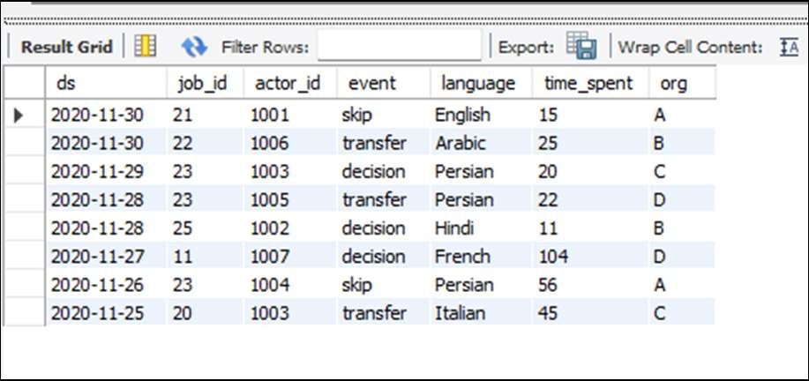
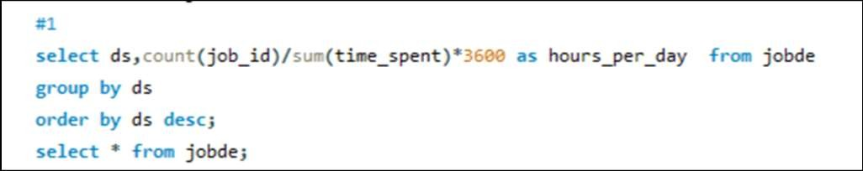
#1 Insights (case study 1):-
Number of jobs reviewed: how many jobs have been examined throughout time.
Result: the daily and hourly rate of employment examined for November 2020.

Slide 5
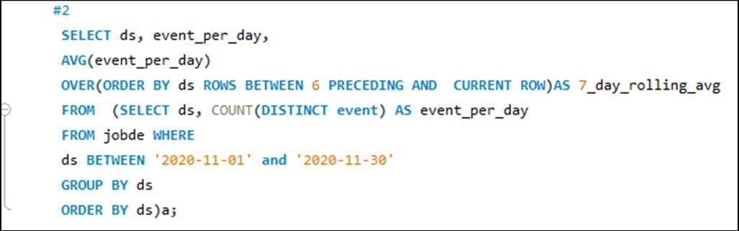
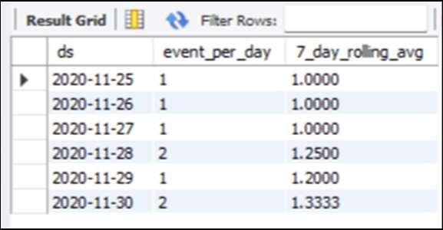
#2 Insights (case study 1):-
Throughput: It is the no. of events happening per second.
Result: 7-day rolling average of throughput

Slide 6
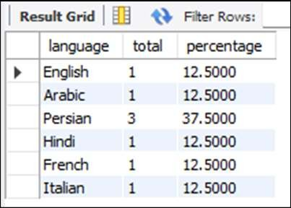
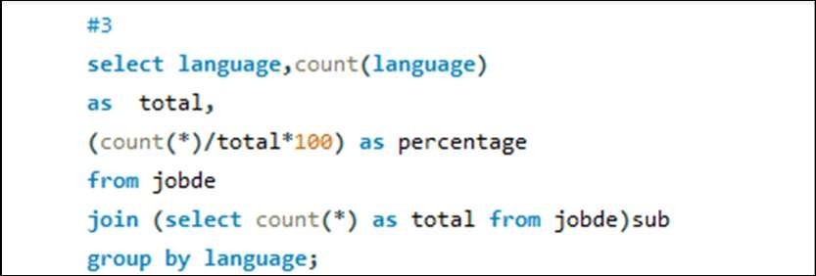
#3 Insights (case study 1) :-
Percentage share of each language: Share of each language for different contents.
Result: Percentage share of each language: Share of each language for different contents.

Slide 7
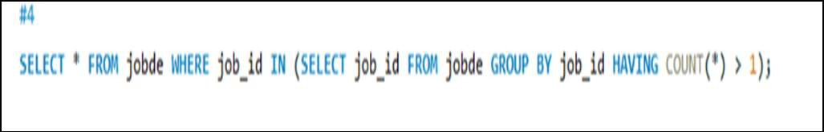
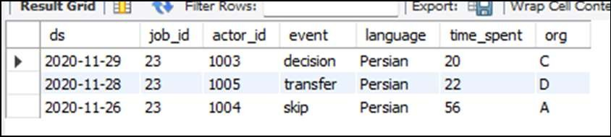
#4 Insights (case study 1):-
Duplicate rows: Rows that have the same value present in them.
Result: duplicates from the table

Slide 8
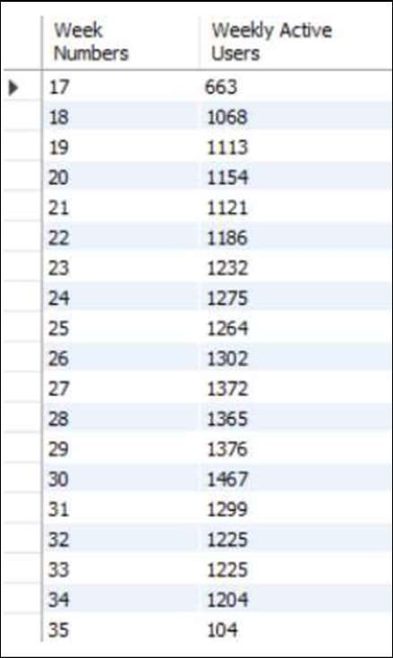
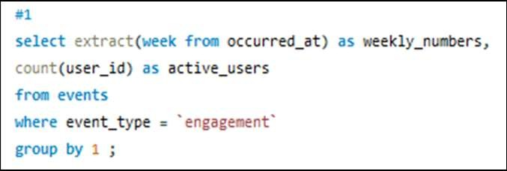
# 5 Insights (case study 2) :-
User Engagement: To measure the
activeness of a user. Measuring if the user Result: the weekly user engagement finds quality in a product/service.

Slide 9
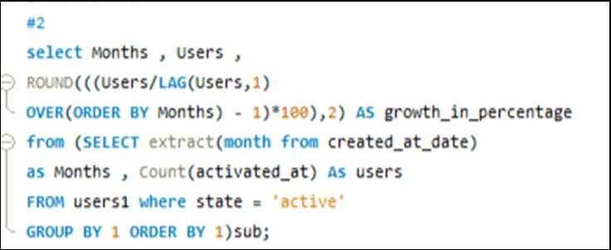
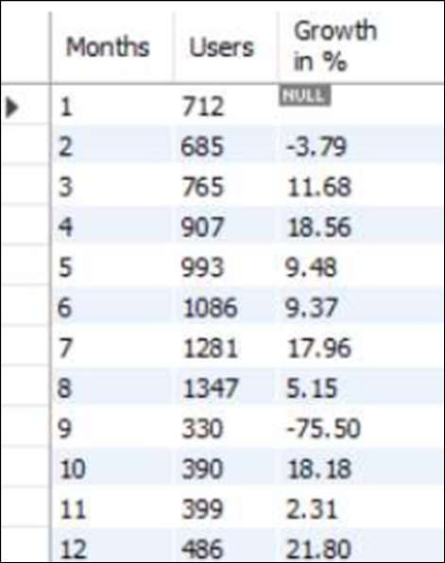
#6 Insights (case study 2) :-
User Growth: Amount of users growing over time for a product.
Result: the user growth for the product

Slide 10
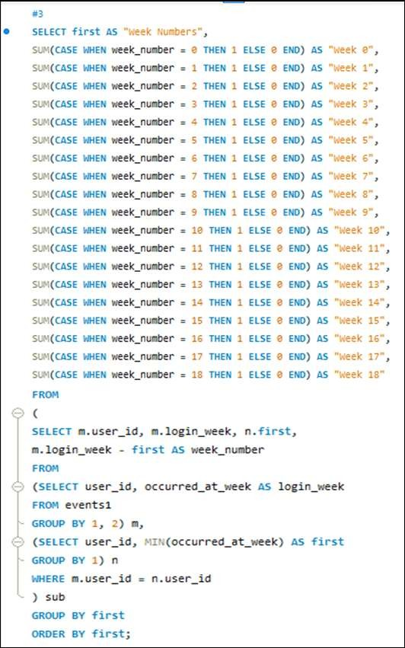
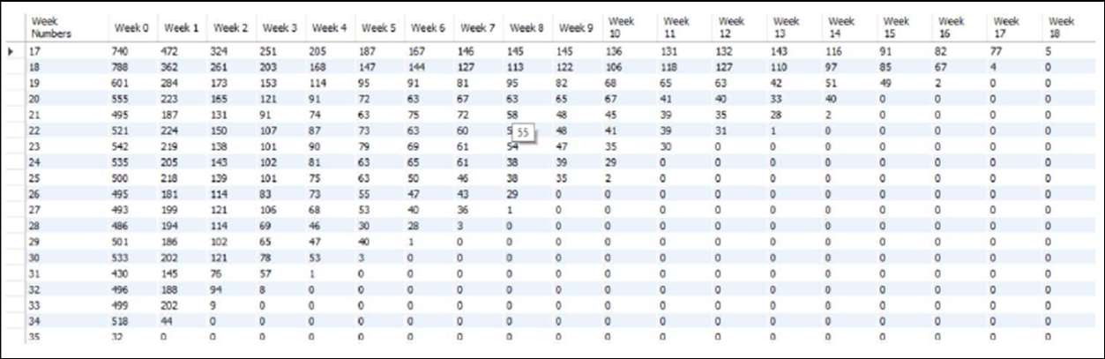
#7 Insights (case study 2) :-
Weekly Retention: Users getting retained weekly after signing up for a product
Result: the weekly retention of users-sign up cohort.

Slide 11
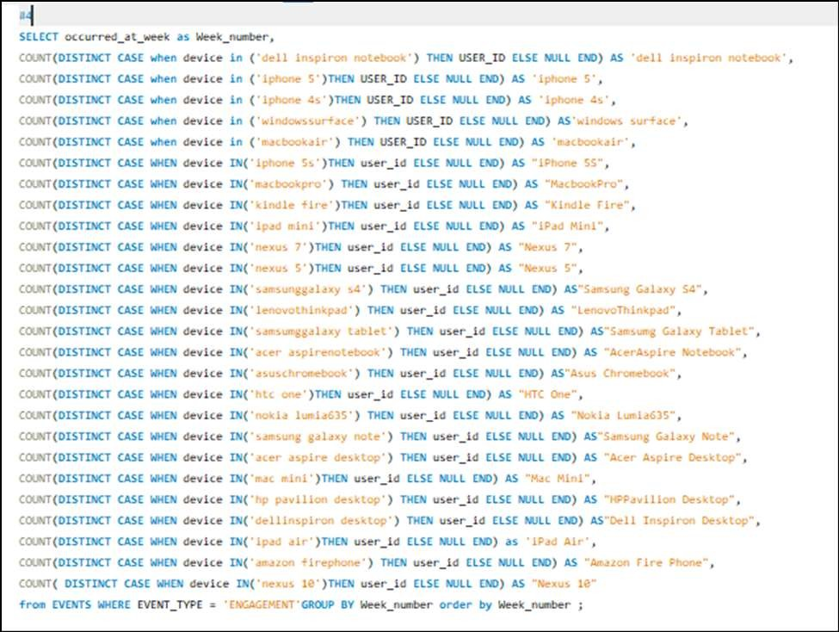
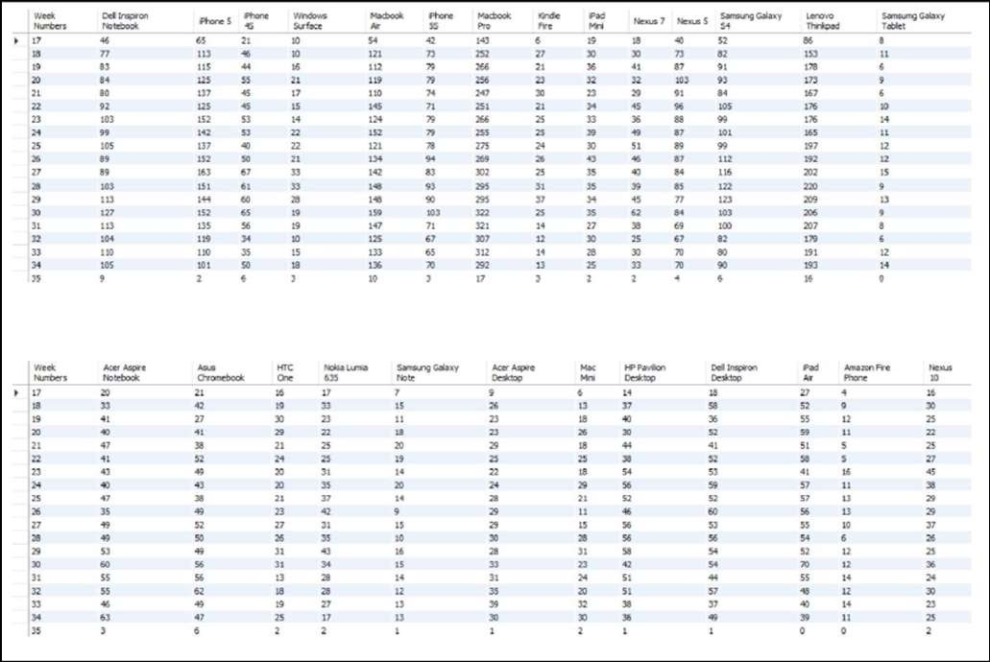
#8 Insights (case study 2) :-
Weekly Engagement: To measure the activeness of a user. Measuring if the user finds quality in a product/service weekly.
Result: the weekly engagement per device

Slide 12
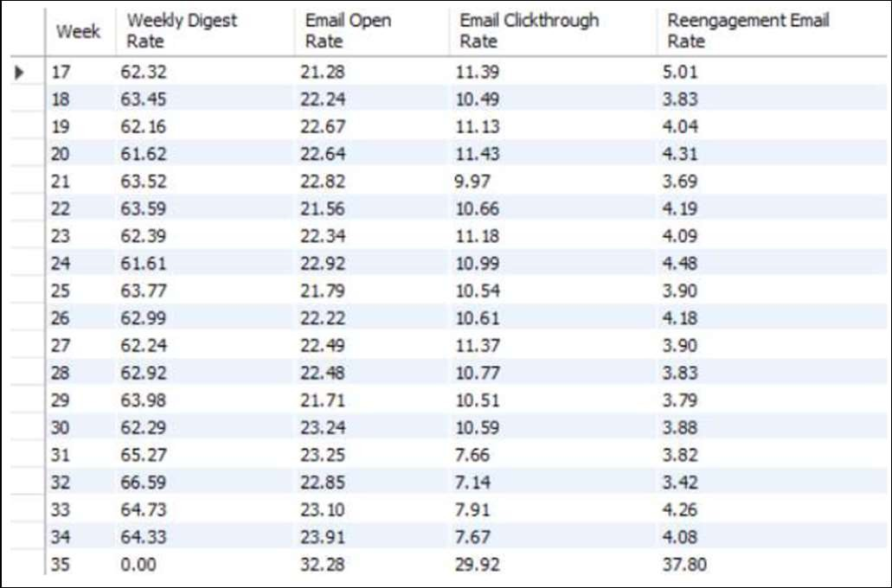
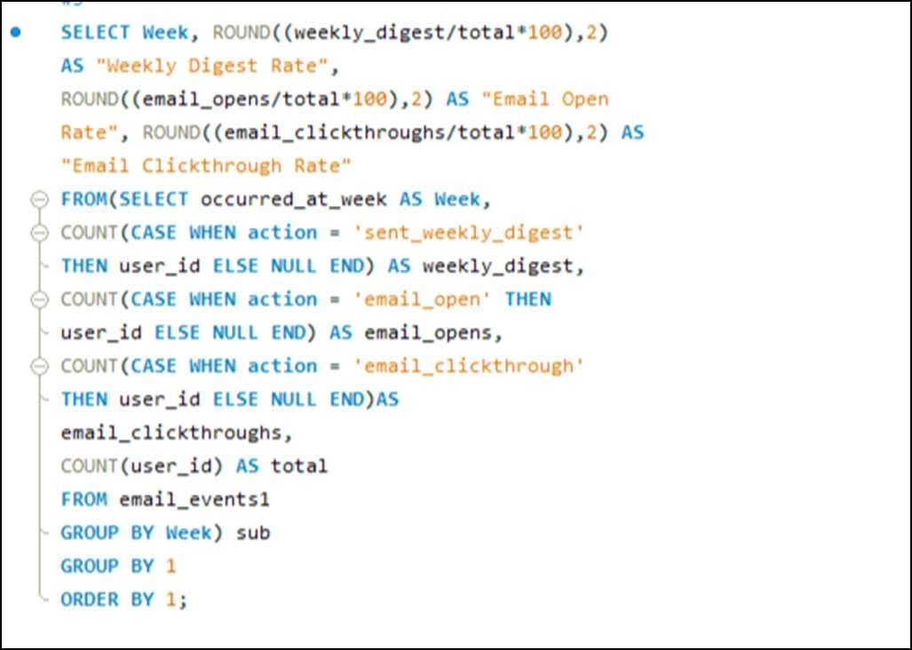
# 9 Insights (case study 2) :-
Email Engagement: Users engaging with the email service.
Result: the email engagement metrics

Slide 13
Result:
This study improved my understanding of the value of operational analytics as well as how businesses employ metric spikes as a covert weapon to monitor daily business growth. Additionally, I gained knowledge about CTE, or Common Table Expression, which assisted me in resolving issues like calculating the Case Study 1 Question 3 language use percentage.

